Slide 1
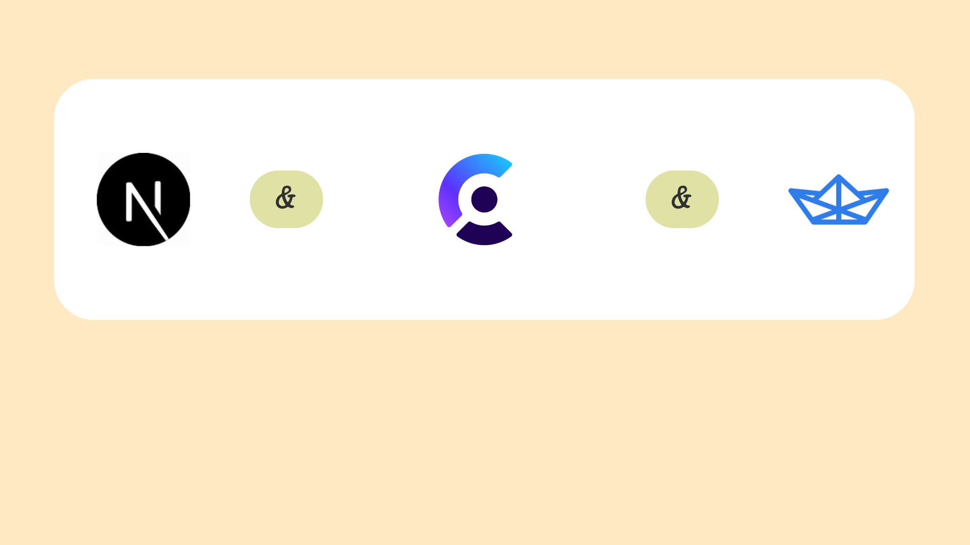
Technologies Used

Slide 2
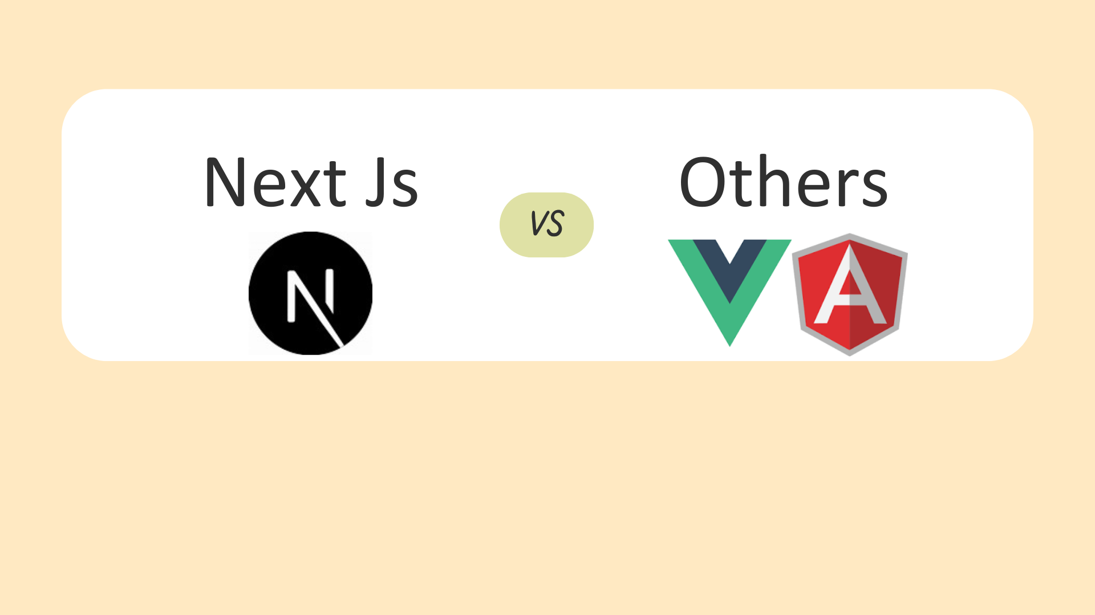
Why Choose Next Js?

Slide 3
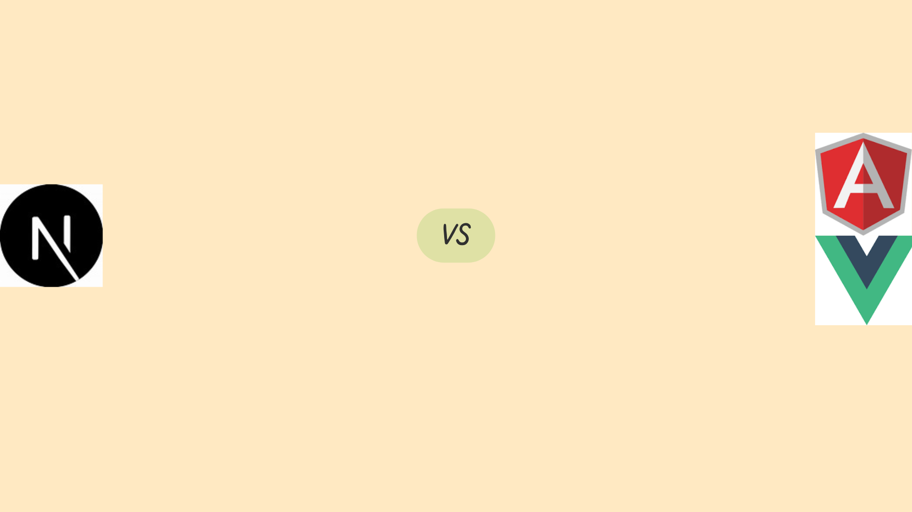
Compare to Angular Js
Simpler Learning Curve: Next.js is easier to learn than Angular.js.
Faster Development: Next.js provides faster development and deployment.
Better Performance: Next.js's SSR and SSG improve performance.4.
Easier Integration: Next.js integrates well with other libraries and frameworks.

Slide 4
Compare to Vue Js
Easier Server-Side Rendering: Next.js provides built-in SSR, while Vue.js requires additional setup.
Faster Development: Next.js provides faster development and deployment.
Better Performance Optimization: Next.js includes automatic code splitting and caching.
Simplified Routing: Next.js has a simpler routing system.

Slide 5
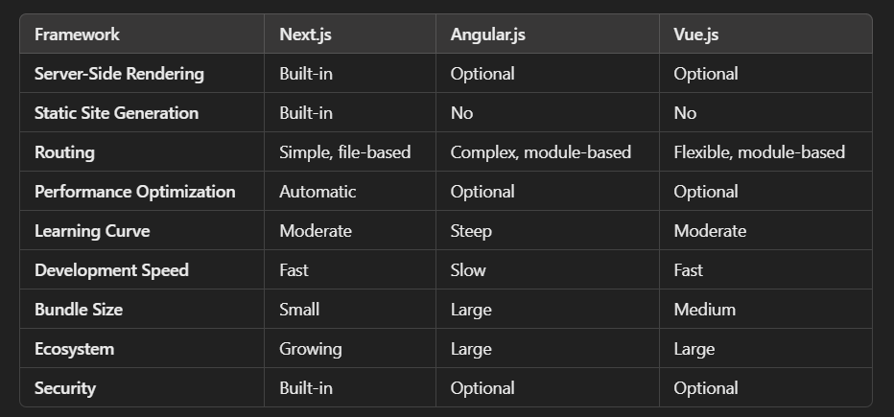

Slide 6
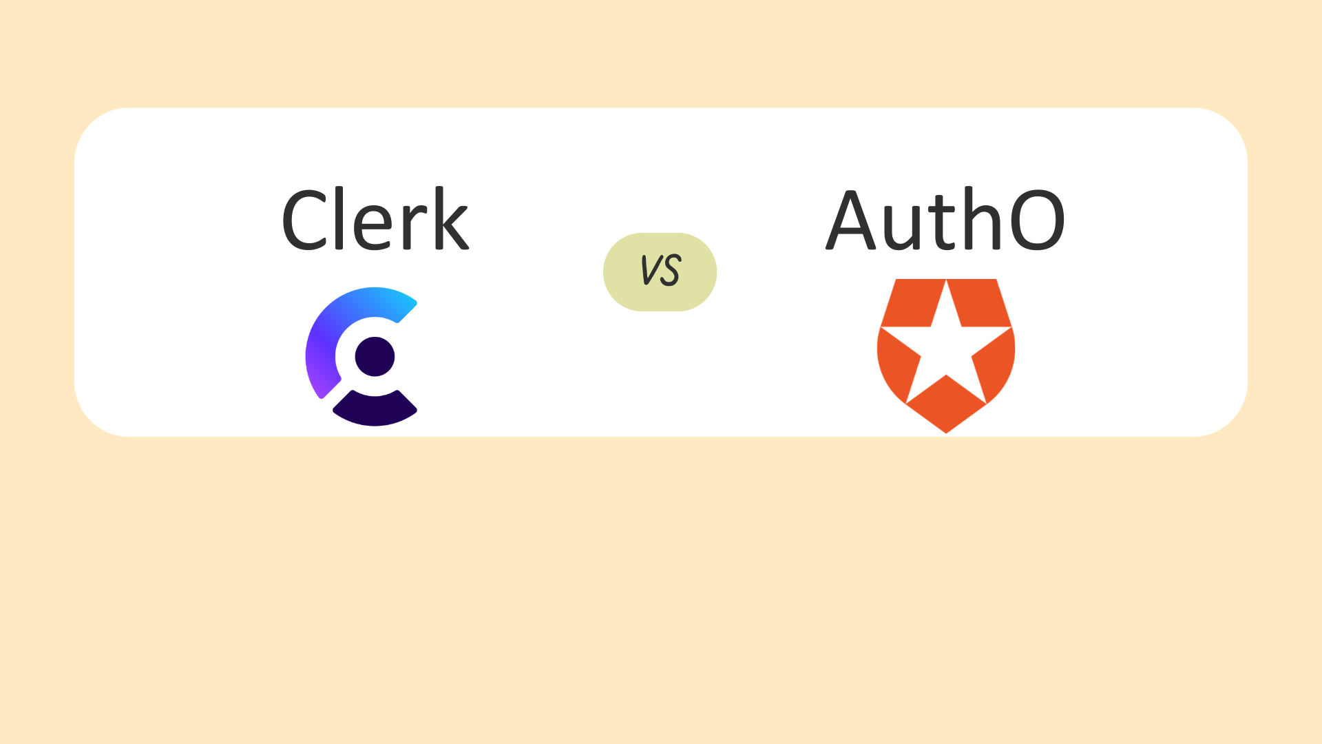
Why Choose Clerk(authentication)?

Slide 7
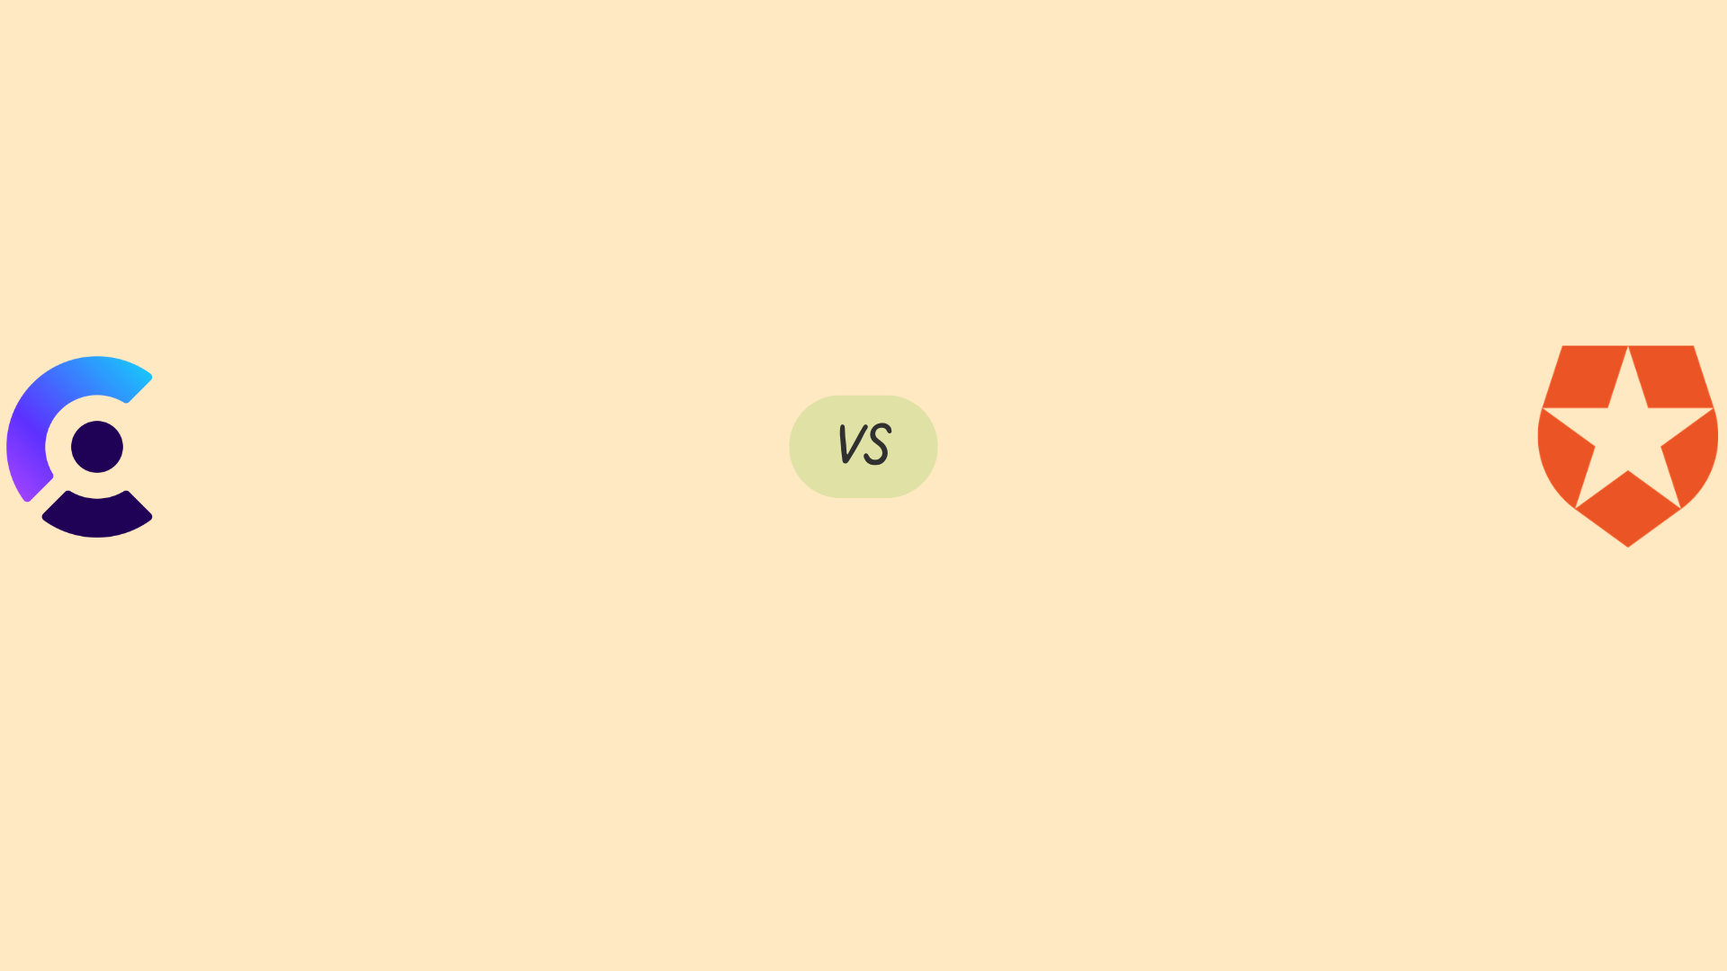
What Clerk provides what Auth0 doesn’t
Prioritize simplicity and ease of use.
Need cost-effective solutions for small to medium-sized applications.
Require advanced security features and compliance support.
Want customizable UI components and authentication methods.
You prefer fast development and deployment.

Slide 8
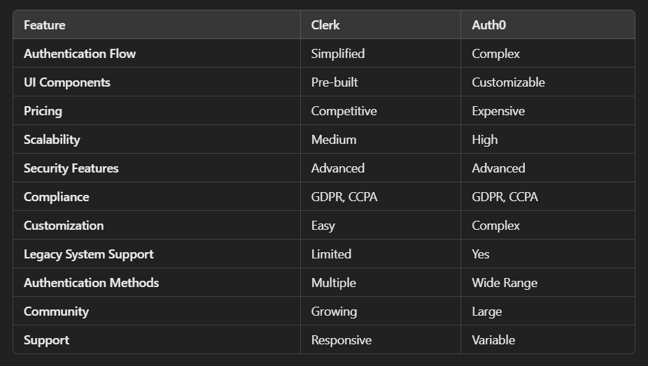

Slide 9
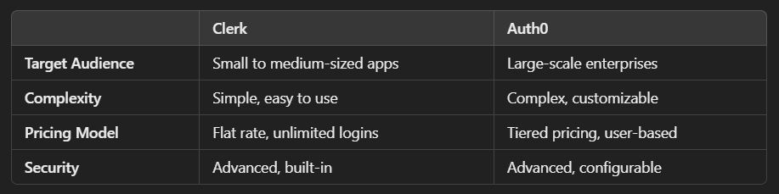

Slide 10
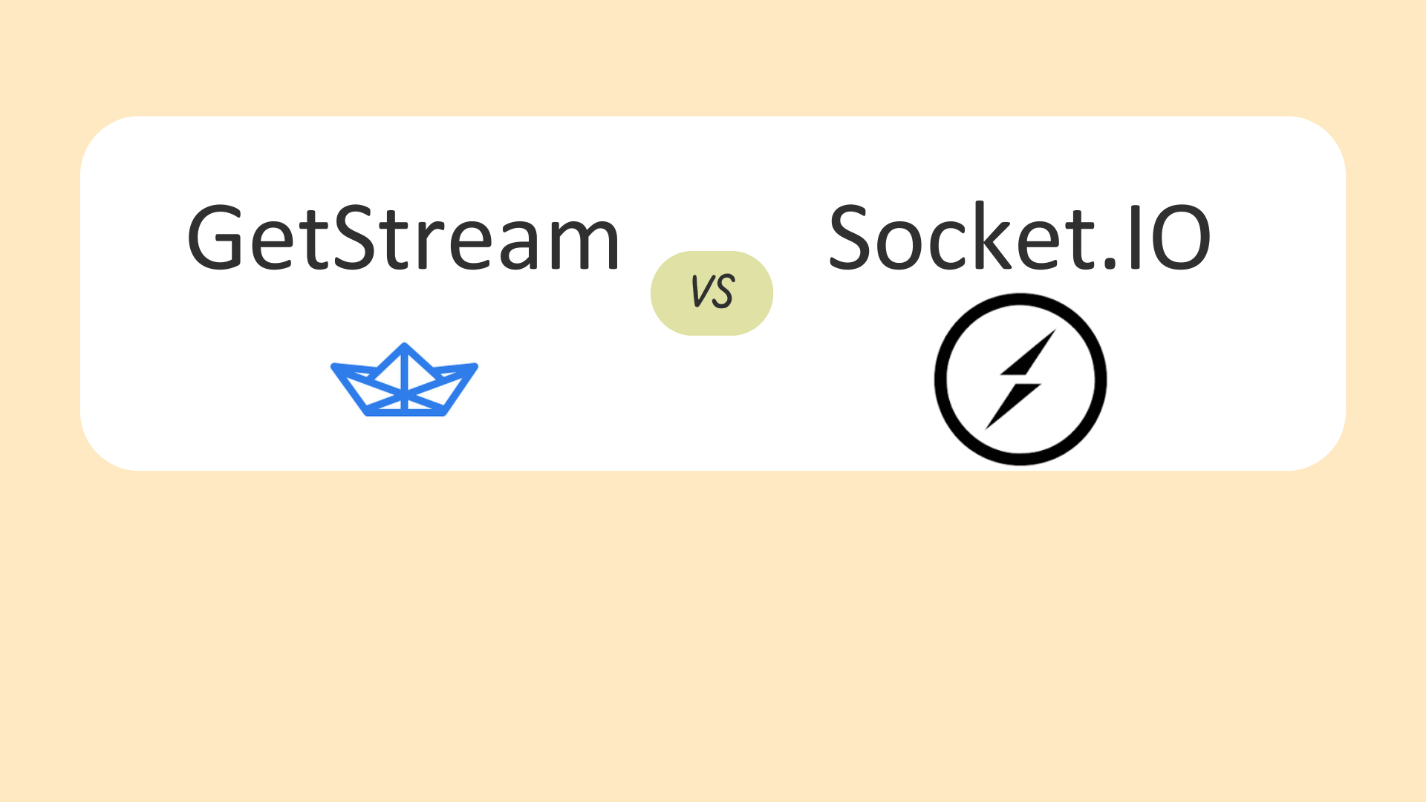
Why Choose GetStream?

Slide 11
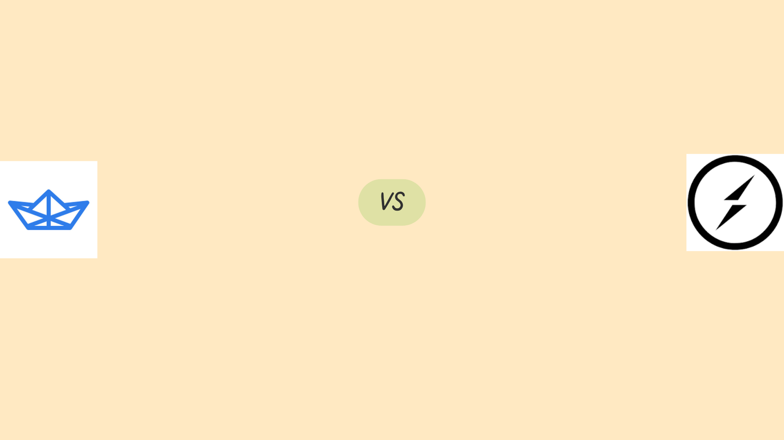
Why GetStream over SocketIO
You want a quick-to-deploy chat or activity feed solution.
You need pre-built components like read receipts, file sharing, and message threading.
You are looking for a fully managed, scalable service.
You want built-in security and compliance (GDPR, CCPA).
You need analytics and insights into chat and user behavior.

Slide 12
